Slide 1
CITIZENSHIP AMENDMENT ACT 2019
MEGHA M
meghamurali6@gmail.com

Slide 2
INTRODUCTION
What is Citizenship?
Citizenship is the legal right to belong to a particular country.
In other words, citizenship bestows upon individuals membership in a national political community.
Citizens enjoy civil and political rights in a sovereign state.
Citizenship within the Indian Constitution: The Constitution of India provided for Citizenship to Indians under Article 5 to 11

Slide 3
INDIAN CONSTITUTION
The Constitution of India provided for Citizenship to Indians under Articles 5 to 11.
1) Article 5: provides for citizenship by domicile.
2) Article 6: grants citizenship to persons who migrated from Pakistan to the present India before the commencement of the Constitution of India
3) Article 7: confers citizenship on those persons who migrated to Pakistan after announcement of Independence but later returned back to India
4) Article 8: provides for citizenship to those persons whose parents or grandparents were born in India, but are resident of abroad
5) Article 9: provides that any person who acquired the citizenship of any other country will not be entitled to the citizenship of India.
6) Article 10: states that all citizens shall continue to be citizens of India
7) Article 11: confers power on the Parliament to make rules regarding citizenship

Slide 4
What is Citizenship Amendment Act 2019?
The Citizenship (Amendment) Act, 2019 was passed by the Parliament of India on 11 December 2019. It amended the Citizenship Act, 1955 by providing a pathway to Indian citizenship for refuges from Afghanistan, Bangladesh and Pakistan who are Hindus, Sikhs, Buddhists, Jains, Parsis or Christians, and arrived in India before the end of December 2014. The law does not grant such eligibility to Muslims from those three countries, all of which are Muslim-majority countries. The act was the first time that religion had been overtly used as a criterion for citizenship under Indian law.

Slide 5
Why people are protesting against CAA?
There was widespread protests across the country including the national capital region and northeastern states against the CAA amendment.
The protest in Assam and other northeastern states turned violent over fears that the move will cause a loss of their “Political rights, culture & land rights” and motivate further migration from Bangladesh.
The agitators say that new amendment in Citizenship Act discriminates against Muslims and violates the right to equality enshrined in the Constitution of the Country.
Sects like Shias and Ahmedis also face persecution in Muslim-Majority countries like Pakistan but are not included in the CAA.
Questions were also raised on the exclusion of persecuted religious minorities from other region such as Tibet,Sri Lanka and Myanmar.

Slide 6
Who will benefit from the law?
The Citizenship(Amendment) Act grants citizenship to Hindus, Christians, Sikhs, Buddhist, Jains and Parsis – from Afghanistan, Pakistan and Bangladesh who had arrived in India before December 31,2014.
The legislation applies to those who were “forced or compelled to seek shelter in India due to persecution on the ground of religion.It aims to protect such people from proceedings of illegal migration from the neighbouring countries

Slide 7
What makes Citizenship Act controversial?
There are two distinct rallying points of protests against the Act. In the northeast, the protest is against the Act’s implementation in their areas. Most of them fear that if implemented ,the Act will cause a rush of immigrants that may alter their demographic and linguistic and cultural uniqueness. In the rest of India, like in Kerala, West Bengal and in Delhi, people are protesting against the exclusion of Muslims, alleging it to be against the ethos of the Constitution as it makes religion a criterion for granting India citizenship to immigrants.

Slide 8
Inferences made from the Twitter Analysis on #caa
1.'#caa' is the popular hashtag on twitter about citizenship amendment act
2. These are the words with high frequency count:
'rt,telecom,destroy,towers,kanchangupta'
From unigram DTM by the frequency of words, just made a conclusion that people are talking about telecom ,towers or some thing that is destroyed.
But we cannot relate the words or get properly relate the matter what people are talking about.

Slide 9
3.These are the words with high Tf-Idf score:
'destroy telecom, telecom towers, rt kanchangupta, caa nothing,
law nytimes, nytimes caa'
From Bigram DTM after sorting on Tf - idf score, its clear that people are talking about the protects made against CAA. They destroyed telecom as a part of protests. Moreover discussing about CAA
Bigram DTM with TF-IDF score is giving us more idea than Bigram DTM with frequency count

Slide 10
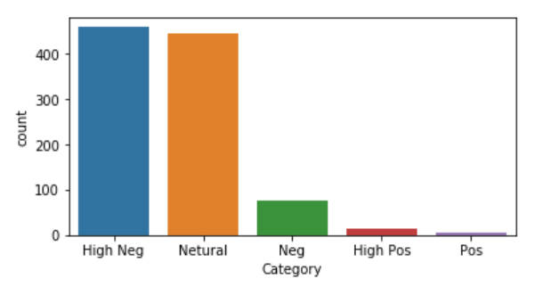
4.Peoples attitude towards CAA is 'Negative'
But 'Neutral' is also having some what same count as negative
So that, we can conclude People as a whole has both Negative and Neutral attitude towards CAA.

Slide 11
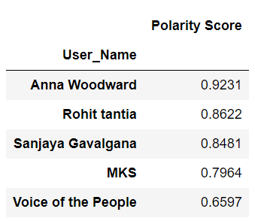
5.Top 5 user having High positive attitude towards CAA:

Slide 12
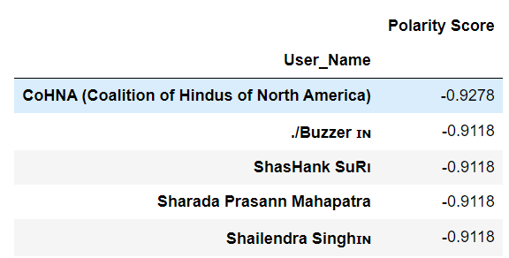
6.Top 5 user having High Negative attitude towards CAA:

Slide 13
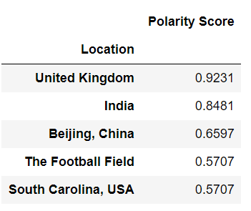
7.Top 5 Location having High positive attitude towards CAA:

Slide 14
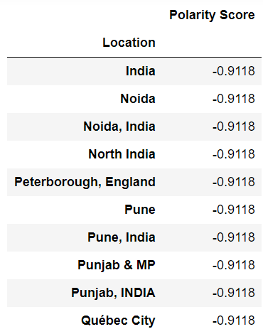
8.Top 5 Location having High Negative attitude towards CAA:
Noida ,India
Peterborough, England
Pune
Punjab & MP
Quebec City, Canada
Northern side of India strongly oppose CAA because its showing some religious discrimination.

Slide 15
Conclusion
The Act should be seen in a positive light as it seeks to address the plight of persecuted minorities who had no other option aside from coming to India illegally.
However, the government must look to accommodate the Ahmadiyyas, Uyghurs and Rohingyas who are persecuted minorities and have approached India to seek refuge in time of need.
Further, the government should also formulate policies and take appropriate measures to provide education, employment and a decent living to the concerned migrants.
The government should take necessary steps to assure that the rights and socio-cultural identity of indigenous people is not affected.

